Slide 1

DCAB016
DIP Change and Advisory Board

Slide 2

DCAB016
Introduction
Welcome and apologies, James Stokes, DCAB Chair
  Information item(s)
DIP Manager Report, Ayi Edet (AE), Rob Golding (RG)
DIP Manager Change Report, Sean Dryden-Woods (SDW)
Discussion Items
4) DIP Assurance Strategy, Taz Islam (TI)
Closing Items
5) Actions and minutes, SDW
6) Any Other Business (AOB)
Agenda

Slide 3
Welcome and apologies
01
James Stokes, DCAB Chair

Slide 4
DIP Manager System Report
02
Ayi Edet, Product Owner DIP

Slide 5
DIP Manager System Report
The DIP Manager, working with the DIP Service Provider, is making progress on delivering 14 system changes to both the DIP and the DIP Portal. To note:
The next scheduled release system changes will take place on 13 August 2026 as part of a DIP Manager monthly. Initially, the plan was to implement the changes in June 2026; however, this timeline was adjusted to allow for thorough testing.
This conservative approach was adopted by the DIP Manager to minimize potential delivery risks, defects, and issues.
The DIP Manager's last implementation, system changes on 12 March 2026, was communicated via DIP Updates and an Elexon Circular. To note:
No issues have been identified, the DIP performance is stable, and the DIP has been rebased for future releases.
The DIP Manager has also published its System Change Roadmap, which sets out the activities that will be undertaken in the next twelve months.

Slide 6
DIP Manager System Report – August Release
S/N | Change | Development Update | Stage | Testing Type | RAG | Issues / Risks / Dependencies
1 | SUR Alphanumeric Validation | Testing in progress | Build / Testing | Internal + External | G | On track
2 | Retry & Back-off Interval Update | Testing in progress | Build / Testing | Internal | G | On track; No material risks
3 | REP900 Swagger Update (v008 → v009) | Swagger update in progress | Refinement | Internal | A | Dependent on Swagger doc finalisation
4 | DLQ Alerting Improvements | Development progressing as planned | Build (In progress) | Internal | G | On track; No material risks
5 | Duplicate SUR Feedback | Testing in progress | Build / Testing | Internal + External | G | On track; No material risks
6 | Portal Dashboards (Ops & System Reporting) | Early planning for dashboard capability | Backlog | Internal | A | Large item; capacity dependent
7 | Reporting Data Platform Enablement | Scope and design in progress | Backlog | Internal | A | Foundational: Sizing and architecture dependency
8 | Download MP List & Roles | Development in progress | Build (in progress) | Internal | G | Low complexity
9 | Portal Announcements Section | Testing in progress | Build / Testing | Internal | G | On track; No material risks

Slide 7
DIP Manager System Report - August Release
S/N | Change | Development Update | Stage | Testing Type | RAG | Issues / Risks / Dependencies
10 | Status Message Replay | On hold | Design Review / On hold | Internal + External | R | Paused for redesign – replan required
11 | Bulk Message Replay (Large Volumes) | On hold | Design Review / On hold | Internal + External | R | Paused for redesign
12 | Trace Missing / Invalid Sender ID | Not yet started | Pending | Internal | A | Awaiting progression
13 | L1/L2 Validation (Future Timestamp) | Development in progress | Build (in progress) | Internal + External | G | Low risk; in test phase
14 | Align Retry Behaviour (HTTP Codes) | Ready for development | Backlog | Internal | A | Design alignment require
The August release reflects the current delivery position across the DIP backlog:
Majority of items progressing in build and testing
Replay and requeue capability currently under design review due to opportunity to mitigate cost and improve performance whilst aligning to data best practices
Dependencies include Swagger finalisation and design alignment with Avanade/Microsoft
August release scope will be confirmed following resolution of these design considerations

Slide 8
DIP Archive Update
To explain the RED status behind the S/N 10 & 11 referenced in the two previous slides:
Avanade (DIP Service Provider) have identified an increase in costs associated with the DIP archive specifically around the cost of indexes and identified an opportunity to redesign which improves performance and cost
This provided an opportunity to the DIP Manager to consider the use of the DIP archive and aligning it with the wider Elexon data strategy and the role that other systems in the ecosystem provide (Electricity Enquiry Service (EES))
Examining requirements that use the DIP archive – there are three:
  General use for replay/requeue (Non-functional)
  IF015/IF-016 messages – used for SDS initialisation and uses the IF-021/IF-015/IF-014 archive (4-month requirement)
  IF-040 message sent to new supplier off the back of IF-036 (30-day requirement)
Exploring the option of moving the requirements 1&2 into the Data Acquisition Hub (DAH), which is Elexon's strategic data store for metering data
The cost of the development/testing/deployment work would quickly be recovered by the reduction in the storage costs
Replay/Requeue requirement:
  Q. How long should data be retained in the archive for replay/requeue? How far back should users be able to reload data? Consider EES is the source of MPAN data in the event of data loss as DIP archive not guaranteed to have the required data. Hence how long should parties have access to the DIP archive?
      2 years – current requirement inherited from programme
      4 months – align to IF-015/IF-016 requirement
      1 month - DIP Manager recommendation

Slide 9
DIP System Change Roadmap for current 26/27 DIP Year
The DIP Manager has created a roadmap for system changes planned for development, testing, and implementation during the upcoming DIP Year (2026/27).
The DIP Manager system change road map is structured around three phases:
Stabilisation (April – August);
Enduring (August – November); and
Business as usual (December – March).
By adopting a three-phase approach, the DIP manager will improve user experiences, enhance reporting functionality, strengthen platform robustness, and embed sustainable processes.

Slide 10
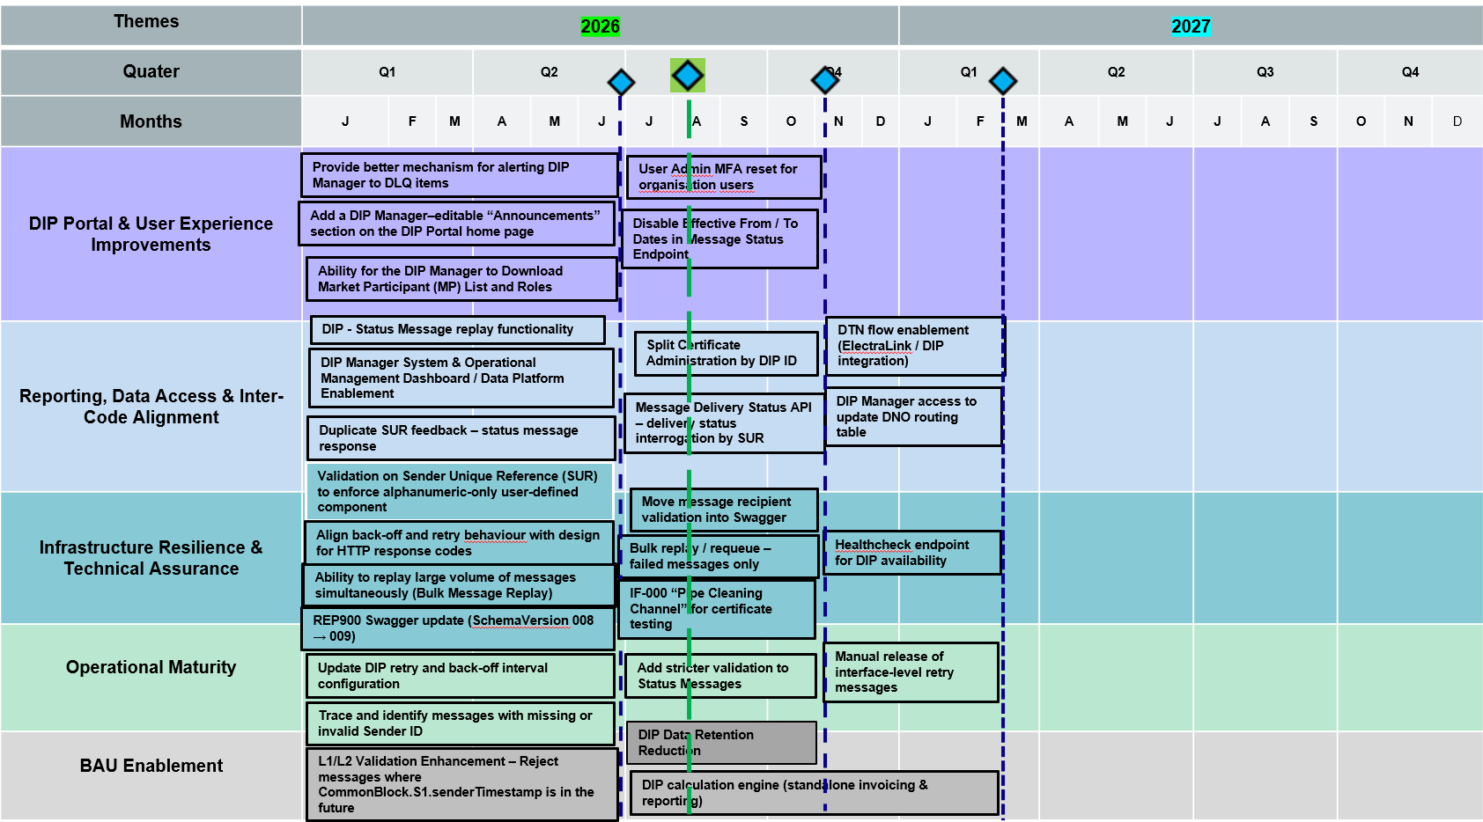
DIP System Change Roadmap for current DIP Year

Slide 11
DIP System Change Roadmap for Apr'26 to Aug'26
From April to August, the DIP Manager will focus on:
DIP Portal and user experience improvements, including editable announcements capability, DLQ alerting, MP list, and roles download
Reporting and operational visibility improvements, such as message status replay, duplicate SUR feedback, and operational dashboards
Infrastructure and resilience improvements, including bulk message replay, retry/back-off configuration, and message tracing
Documentation and schema alignment through Swagger updates

Slide 12
Themes | 2026 |  |  | Nov 23
Months |  | APR | MAY | JUN | JUL | AUG
DIP Portal & User Experience Improvements
Reporting, Data Access & Inter-Code Alignment
Infrastructure Resilience & Technical Assurance
Operational Maturity
BAU Enablement
Testing
Provide better mechanism for alerting DIP Manager to DLQ items
Add a DIP Manager–editable “Announcements” section on the DIP Portal home page
Ability for the DIP Manager to Download Market Participant (MP) List and Roles
DIP - Status Message replay functionality
DIP Manager System & Operational Management Dashboard / Data Platform Enablement
Duplicate SUR feedback – status message response
Validation on Sender Unique Reference (SUR) to enforce alphanumeric-only user-defined component
Ability to replay large volume of messages simultaneously (Bulk Message Replay)
REP900 Swagger update (SchemaVersion 008 → 009)
Align back-off and retry behaviour with design for HTTP response codes
Update DIP retry and back-off interval configuration
Ability to trace and identify messages with missing or invalid Sender ID
L1/L2 Validation Enhancement – Reject messages where CommonBlock.S1.senderTimestamp is in the future

Slide 13
DIP System Change Roadmap for Aug'26 to Nov'26
From August to November, the DIP Manager will focus on:
Enhanced reporting and data access, including message delivery status interrogation (SUR-based APIs), improved operational reporting visibility, and data retention optimisation
Inter-code and cross-network alignment, including certificate administration improvements (split by DIP ID) and delivery transparency supporting assurance activities
Improvements to testing and technical assurance tooling, including recipient validation moved into Swagger, stricter status message validation, schema alignment, and IF-000 certificate testing channel capability
Refinement of operational tooling and portal self-service capabilities, including bulk replay/requeue for failed messages, user-admin MFA reset functionality, and message status endpoint enhancements to support enduring operational usage

Slide 14
Themes | 2026 |  |  | Nov 23
Months |  | AUG | SEP | OCT | NOV | DEC
DIP Portal & User Experience Improvements
Reporting, Data Access & Inter-Code Alignment
Infrastructure Resilience & Technical Assurance
Operational Maturity
BAU Enablement
Testing
DIP User Admin MFA reset for organisation users
Disable Effective From / To Dates in Message Status Endpoint
Fix broken links in Quick Links section on DIP Portal Home page
Split Certificate Administration by DIP ID
Message Delivery Status API – delivery status interrogation by SUR
DIP Data Retention Reduction
Move message recipient validation into Swagger
Bulk replay / requeue – failed messages only
IF-000 “Pipe Cleaning Channel” for certificate testing
Add stricter validation to Status Messages

Slide 15
DIP System Change Roadmap for Dec'26 to Mar'27
From December to March, the DIP Manager will focus on:
Scaling participant onboarding and operational support capabilities, building on improved portal and governance controls
Platform resilience and monitoring improvements, including healthcheck capabilities and strengthened operational visibility
Consolidation of lessons learned into enduring operational guidance, governance artefacts, and documentation
Maturing of operational tooling and assurance practices, embedding replay, validation, monitoring, and reporting capabilities into BAU processes

Slide 16
Themes | 2027
Quater | Q4
Months | JAN | FEB | MAR
DIP Portal & User Experience Improvements
Reporting, Data Access & Inter-Code Alignment
Infrastructure Resilience & Technical Assurance
Operational Maturity
BAU Enablement
Testing
DIP Manager access to update DNO routing table
DTN flow enablement (ElectraLink / DIP integration)
Healthcheck endpoint for DIP availability
Manual release of interface-level retry messages
DIP calculation engine (standalone invoicing & reporting)

Slide 17
Any questions?

Slide 18
DIP Change Report
03
Sean Dryden-Woods, Senior Change Lead

Slide 19
DIP Change Request (CR) updates
CR | Stage | Progression | Explanation
DCR0005 'Extending SIT-A Testing Environment ​ | Open, workgroup. | Further assessment, industry workgroup | The DIP Manager is holding workgroups to support this CR. The most recent workgroup was held on 5 March 2026. The workgroup focused on the DIP Manager system release process, the forward schedule of system changes, and the testing environment used by the DIP Manager. ​
DCR0006 'Management of Significant DIP incidents.'​ | Open, upcoming consultation | Further assessment post consultation | The DIP Manager has been developing the legal text for this DIP CR to address the comments raised by consultation respondents. The DIP Manager is seeking to reconsult on this DIP CR later this month or early next month. ​
DCR0009 ‘DIP Status Error Messages affecting Licensed Distribution System Operators’​ | Open | Raised | The DIP Manager is addressing introducing the response codes into the DIP Rules before addressing how status error messages can be resolved​
DCR0011 Change to DIP Portal controls to allow Lead Admin to manage organisation MFA reset​ | Open | Raised | The DIP Manager has added this CR to the system backlog and is seeking to develop this change for the DIP Manager's November release. ​
DCR0012 'House Keeping Changes'​ | Open | Initial Assessment | The DIP Manager has drafted an Initial Assessment and is seeking to implement this change in the coming weeks.​

Slide 20
DIP CR updates
CR | Stage | Progression | Explanation
DCR0014 'Restrict DCP Access to MPIDs and Certificates from the Organisational Level to the DCP Level.' ​ | Open, new | Raised | A DIP user submitted CR 0014 to address the problem that Connection Providers can access MPIDs of organizations they do not manage. The DIP Manager has added this issue to the system backlog and plans to implement functionality to restrict Connection Providers' access by November 2026.​
0015 'Introducing Level 3 and Level 4 response Codes into the DIP Rules ​ | Open, new, consultation | Initial Assessment, Consultation | The DIP Manager is consulting on introducing Level 3 and Level 4 response codes into the DIP Rules ​
DCR0016 ‘Implementation of the data refresh message to ensure alignment of the MHHS design.’ | New, Implemented | Implementation | The DIP Manager has drafted a Change Request with an initial and final assessment for the Balancing and Settlement Code Change Proposal 1607
DCR0017 ‘Amendment of L4 Rejection Non Functional Timing Requirements and exemption.’ | New | Raised | A DIP User submitted CR 0017 to change the Level 4 validation timing requirements in the DIP Rules.

Slide 21
Forward Schedule of System Change
The DIP Manager has developed a roadmap of change for system changes and enhancements, which it is seeking to implement over the next twelve months. Feedback on any of the changes detailed in the schedule is welcome.
The forward schedule of system change (previously horizon scanning log) provides details on these changes and can be found here by following the link below:
https://www.elexon.co.uk/data-integration-platform/documents/changes-and-releases/forward-schedule-of-system-change-2026-2027/

Slide 22
Any questions?

Slide 23
DIP Assurance Strategy
04
DIP Manager – Tazwarul Islam

Slide 24
Risk Operating Plan Consultation
The DIP Manager has updated the DIP Manager Risk Evaluation Document (DM RED) and the DIP Manager Risk Operating Plan (DM ROP) following the consultation.
The DIP Manager has published a summary of the consultation
Overall respondents were happy with the Assurance Strategy for DIP Users
There were some comments on widening the Assurance Strategy to encompass all DIP Participants

Slide 25
DIP Manager Escalation Guidance Note
The DM has been developing a guidance note for DIP Users regarding the routes of escalation the DM can take
The three escalation paths are
DIP Manager Escalation
Code Body Escalation
Authority Escalation
The DM will consider escalating issues if the criteria meet a 'high' non-compliance rating (see next slide)

Slide 26
DIP Manager Escalation – non compliance rating
Impact | Duration
 | Low (one week or less) | Medium (one to six weeks) | High (over six weeks)
Low | Low | Low | Medium
Medium | Low | Medium | High
High | Medium/High | High | Critical

Slide 27
Any questions?

Slide 28
Actions and Minutes
05
Sean Dryden-Woods, Senior Change Lead

Slide 29
Any Other Business
06
All

Slide 30
Thank you

